Slide 1
AI and ML in Cybersecurity

Slide 2
Basics of Python programming:
Variables: In Python, variables are used to store data values. They are created when you assign a value to them using the assignment operator (=). Variables can store different types of data, such as integers, floating-point numbers, strings, lists, dictionaries, etc.
Data Types: Python supports various data types, including integers, floats, strings, lists, tuples, sets, dictionaries, and more. Each data type has its own set of operations and methods for manipulation.
Operators: Python provides a variety of operators for performing operations on variables and values. These include arithmetic operators (+, -, *, /), comparison operators (==, !=, <, >), logical operators (and, or, not), and more.
Control Structures: Control structures in Python allow you to control the flow of execution in a program. This includes conditional statements (if, elif, else) for decision-making, loops (for, while) for iterating over sequences or performing repetitive tasks, and control flow statements (break, continue) for altering the flow of execution.

Slide 3
Python Libraries:
Numpy
NumPy is a fundamental package for scientific computing in Python. It provides support for multidimensional arrays, mathematical functions, linear algebra operations, random number generation, and more.
Key features include:
Arrays: NumPy arrays are the core data structure for representing and manipulating data. They are similar to Python lists but more efficient for numerical computations.
Mathematical Functions: NumPy provides a wide range of mathematical functions for performing operations on arrays, such as arithmetic operations, trigonometric functions, exponential functions, etc.
Linear Algebra: NumPy includes functions for performing linear algebra operations, such as matrix multiplication, matrix inversion, eigenvalue decomposition, and singular value decomposition.

Slide 4
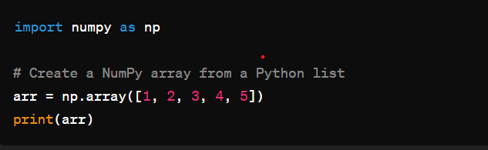
Creating Arrays :
np.array(): Create a Numpy array from a Python list or tuple

Slide 5
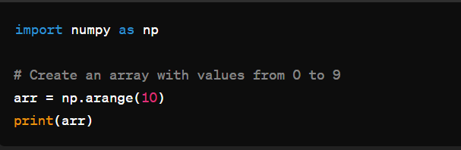
np.arange():Create an array with evenly spaced values within a specified range.

Slide 6
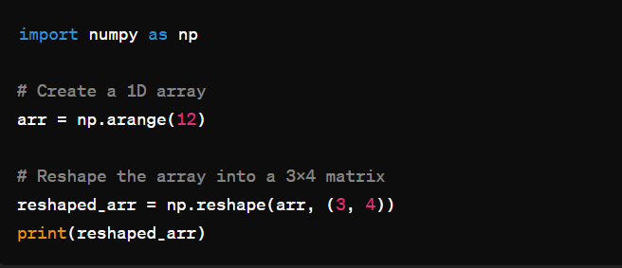
Array Manipulation :
np.reshape() : Reshape an array into a new shape.

Slide 7
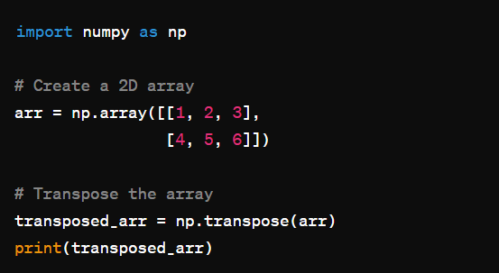
np.transpose() :Transpose the rows and columns of an array

Slide 8
Pandas is a powerful Python library widely used for data manipulation and analysis. It provides data structures and functions to efficiently work with structured data, such as tabular data, time series, and more. Here's an introduction to pandas and some of its important functions:
Data Structures:
Data Frame: A two-dimensional labeled data structure with columns of potentially different types, similar to a spreadsheet or SQL table.
Series: A one-dimensional labeled array capable of holding any data type.

Slide 9
Key Functions:
Reading and Writing Data:
pd.read_csv(): Read data from a CSV file into a DataFrame.
pd.read_excel(): Read data from an Excel file into a DataFrame.
pd.to_csv(): Write data from a DataFrame to a CSV file.
pd.to_excel(): Write data from a DataFrame to an Excel file.
Data Exploration:
df.head(), df.tail(): View the first or last few rows of a DataFrame.
df.info(): Get a concise summary of a DataFrame, including data types and missing values.
df.describe(): Generate descriptive statistics summary of numerical columns in a DataFrame.

Slide 10
Data Manipulation:
df.drop(): Remove rows or columns from a DataFrame.
df.rename(): Rename columns or index labels in a DataFrame.
df.sort_values(): Sort rows of a DataFrame by one or more columns.
df.groupby(): Group rows of a DataFrame by one or more columns.
Data Cleaning:
df.isnull(), df.notnull(): Check for missing values in a DataFrame.
df.fillna(): Fill missing values with specified values or methods.
df.dropna(): Drop rows or columns with missing values from a DataFrame.

Slide 11
Matplotlib is a popular Python library for creating static, interactive, and animated visualizations. It provides a wide range of tools for constructing plots, charts, and figures to convey insights from data effectively. Here's an introduction to Matplotlib and some of its important functions and use cases:
Overview of Matplotlib:
Matplotlib is a comprehensive library for creating high-quality visualizations in Python.
It offers a flexible and intuitive interface for generating a variety of plots, including line plots, scatter plots, bar plots, histograms, and more.
Matplotlib can be used standalone or in conjunction with other libraries like NumPy and Pandas to visualize data from various sources.
Key Functions in Matplotlib:
plt.plot(): Create line plots, scatter plots, or combination plots.
plt.scatter(): Generate scatter plots for visualizing relationships between variables.
plt.bar(): Create bar charts for comparing categorical data.
plt.hist(): Construct histograms for visualizing the distribution of numerical data.

Slide 12
plt.imshow(): Display images and 2D arrays as images.
plt.contour(): Generate contour plots to represent 3D data on a 2D surface.
plt.pie(): Create pie charts to represent proportions of categorical variables.
plt.subplots(): Create a grid of subplots for visualizing multiple plots in a single figure.
Use Cases for Matplotlib:
Data Exploration: Matplotlib is essential for exploring datasets visually, allowing users to understand the underlying patterns, trends, and distributions within the data.
Data Presentation: It enables users to present their findings and insights effectively through visually appealing plots and charts, facilitating clear communication of complex information.
Model Evaluation: Matplotlib is commonly used in machine learning and data analysis workflows to visualize model performance metrics, such as accuracy, precision, recall, and ROC curves.
Report Generation: It's instrumental in generating reports, dashboards, and presentations with visualizations embedded, enhancing the storytelling aspect of data analysis.
Publication-Quality Figures: Matplotlib allows users to create publication-quality figures for academic papers, presentations, and publications, ensuring clarity and precision in conveying research findings.

Slide 13
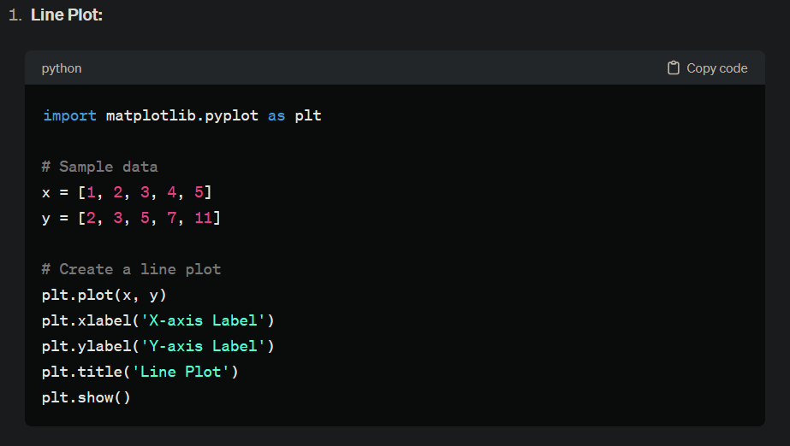

Slide 14
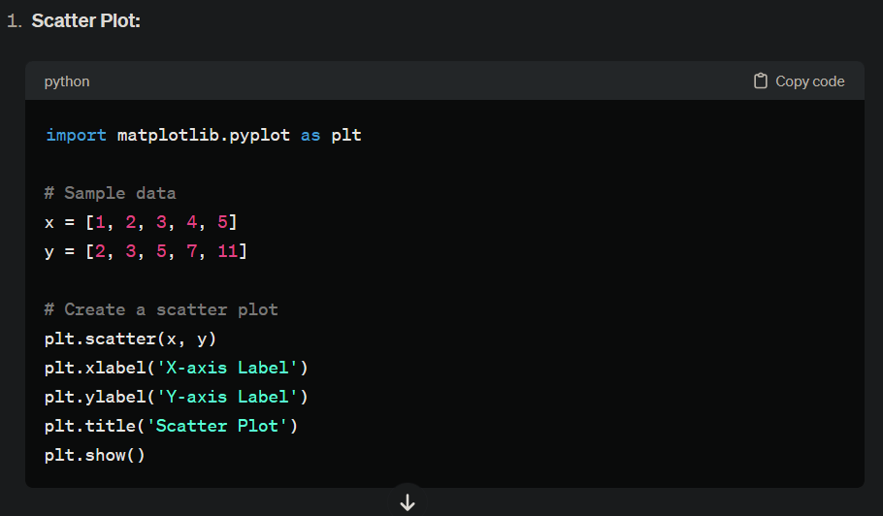

Slide 15
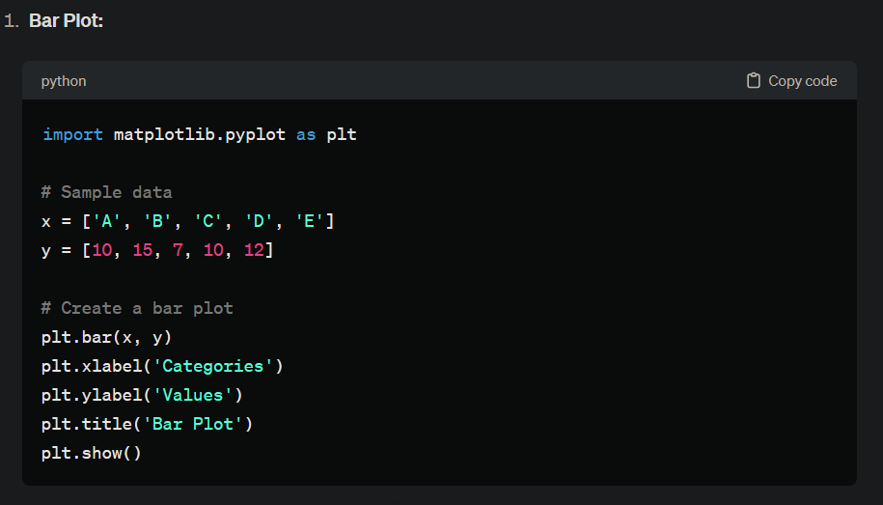

Slide 16
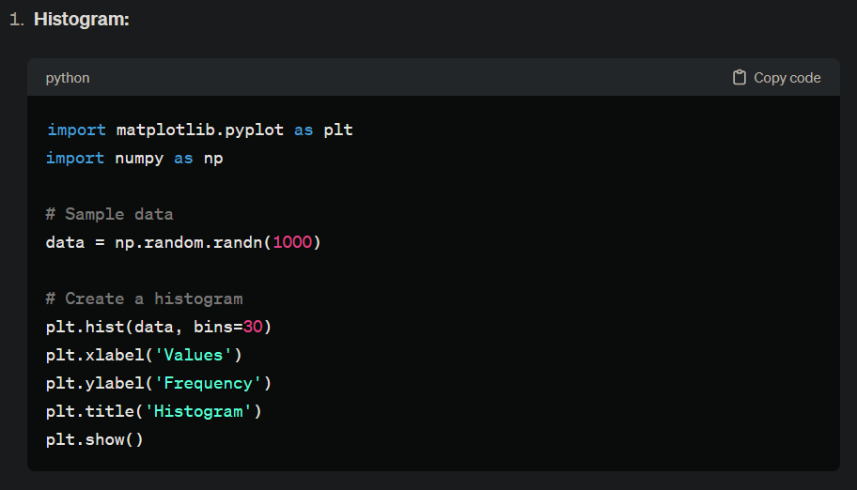

Slide 17
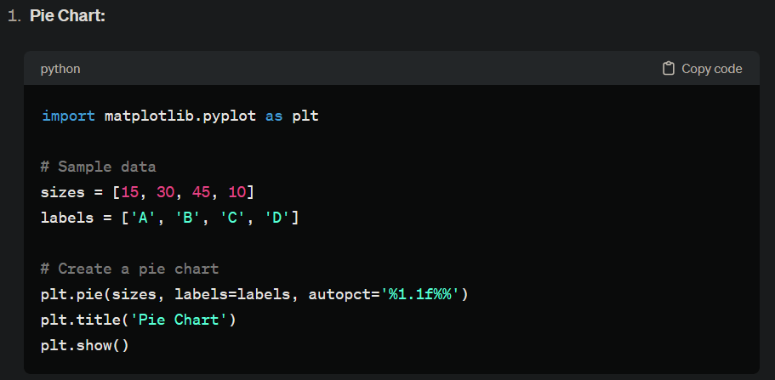

Slide 18
Conclusion
In this session, we explored NumPy, Pandas, and Matplotlib — the three core libraries for data science and analytics in Python.
NumPy helped us understand efficient numerical computing using arrays, vectorized operations, and mathematical functions.
Pandas enabled powerful data manipulation, including loading, cleaning, transforming, and analyzing tabular datasets.
Matplotlib allowed us to visualize data through plots such as line charts, bar graphs, histograms, and scatter plots.

Slide 19

THANK YOU

